Slide 1

Envoy Airlines Performance Analysis
ENVOY Airlines Visualization
-by Pratibha Chitta

Slide 2

ENVOY Airline Visualization
Envoy Airline | % Market Share | Percentage Arrival and Departure Delay | Comparison of Airline by Distance and Flight | .

Slide 3
Envoy Airline | % Market Share | Percentage Arrival and Departure Delay | Comparison of Airline by Distance and Flight | .
United Airlines 6.46%
Op Unique Carrier Alaska Airline Alegiant Air American Airline Delta Air Lines Endeavor Air Envoy Air ExpressJet Frontier Airline Hawaiian Airlines Horizon Air JetBlue
Mesa Airlines PSA Airlines Republic Airways SkyWest Airlines
Southwest Airlin.. Spirit Airlines United Airlines
Flights
American Airline 12.11%
Southwest Airlines 20.79%
Delta Air Lines 12.51%
Endeavor Air 4.73%
SkyWest Airlines 12.86%
Republic Airways 4.79%
Hawaiian Airlines 0.83%
8,780,431

Slide 4
Op Unique Carrier
Alaska Airline Alegiant Air American Airline Delta Air Lines Endeavor Air Envoy Air ExpressJet Frontier Airline Hawaiian Airlines
Horizon Air
JetBlue Mesa Airlines PSA Airlines Republic Airways SkyWest Airlines
Southwest Airlines Spirit Airlines United Airlines
Measure Names Per_Arr_Delay Per_Dep_Delay
0.00 0.02
0.04
0.06
0.08
0.10
0.12
0.14
0.16

Slide 5









16,816
500,000
240
SkyWest Airlines
1,000,000
1,500,000
1,825,626
220
Distinct count of Origin
200
Op Unique Carrier Alaska Airline Alegiant Air American Airline Delta Air Lines Endeavor Air Envoy Air ExpressJet Frontier Airline Hawaiian Airlines Horizon Air JetBlue
Mesa Airlines PSA Airlines Republic Airways SkyWest Airlines
SouthwestAirlines Spirit Airlines United Airlines
180
160
140
Envoy Air
Distribution of Airlines by Distance and Flights
120
Delta Air Lines
100
Republic Airways
80
United Airlines
American Airlines
Frontier Airline
Alaska Airline
Southwest Airlines
60
JetBlue
Endeavor Air
40
Spirit Airlines
20
0
Hawaiian Airlines
0M 200M 400M 600M 800M 1000M 1200M 1400M
Distance

Slide 6
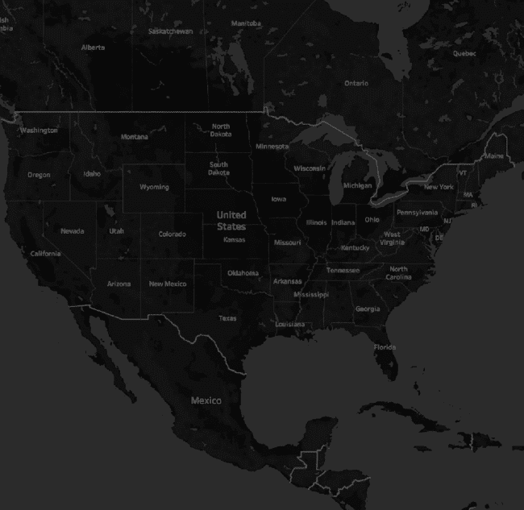
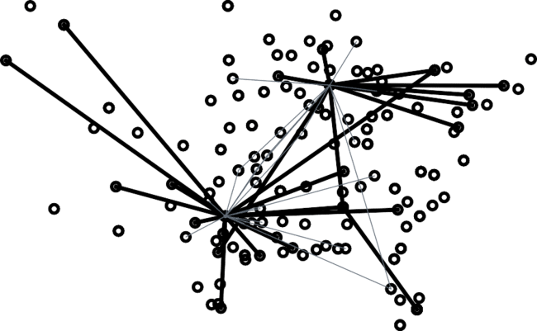
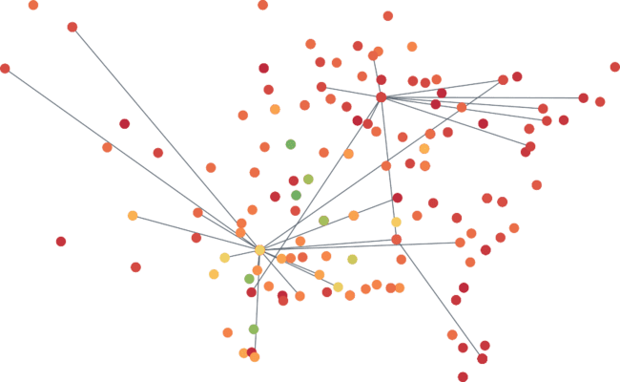






IDS 567 - ENVOY Airline Visualization
Percentage
Comparison of Airline by Distance and Flight
Envoy Network Map with number of Flights
Envoy Hubs
Origin vs Destination
Arrival and De..
Flights
1.0
Month 12
263.0
© 2021 Mapbox © OpenStreetMap

Slide 7
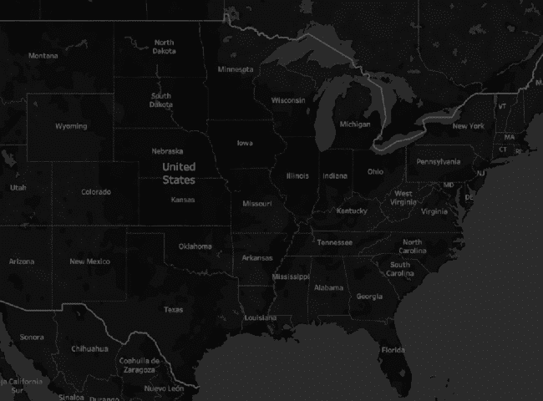


IDS 567 - ENVOY Airline Visualization
Comparison of
Envoy Network Map with number of Flights
Envoy Hubs
Origin vs Destination
Airline Comparison ( Dis..
Airline by Dist..
Flights
6
Flights
115,532
6
20,000
40,000
60,000
80,000
100,000
115,532
© 2021 Mapbox © OpenStreetMap

Slide 8
Most Popular Origin Airports For Envoy Airlines
Origin
DFW MIA ORD SGF XNA
13,009 338 4,132 428 440
Most Popular Destination Airports For Envoy Airlines
Destination
DFW ORD SGF. XNA LIT
12,972 4,128 428 440 476

Slide 9
.
.
.
.
.
.
.
.
.
Envoy Hubs Origin vs Destination
Airline Comparison ( Distance vs Flight)
Envoy vs Rival
.
Share for Envoy vs Republic at Ai..
.
.
.
Op Unique Carrier
Measure Names Distance Flights
.
.
.
It has most similar values like Envoy Airlines
.
.
.
.
.
.
.
.
.
Alask.. Alegi.. Amer.. Delta.. Ende.. Envo.. Expre.. Front.. Hawa.. Horiz.. JetBl.. Mesa.. PSA .. Repu.. SkyW.. Sout

Slide 10
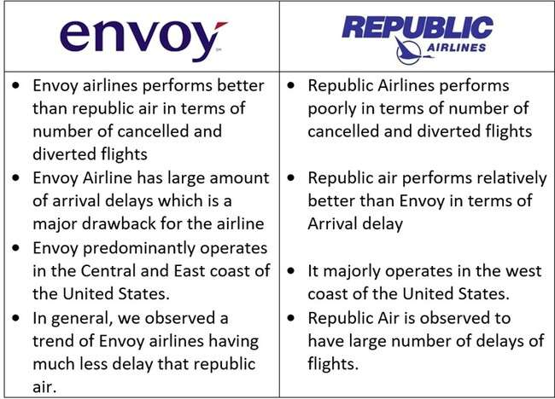
IDS 567 - ENVOY Airline Visualization
Origin vs Destination | Airline Comparison ( Distance vs Flight) | Envoy vs Rival | Share for Envoy vs Republic at Airports | Arrival Delay (Envoy vs Repub..

Slide 11
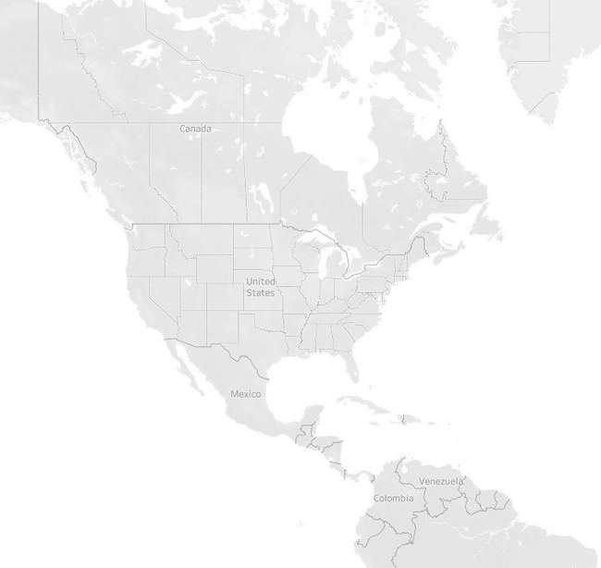

Airline Competition (Envoy vs Rival)
Share for Envoy vs Republic at Airports | Arrival Delay (Envoy vs Republic) | Departure Delay (Envoy vs Repub..
Flights
68
50,000
100,000
159,958
Op Unique Carrier Envoy Air Republic Airways
© 2021 Mapbox © OpenStreetMap

Slide 12
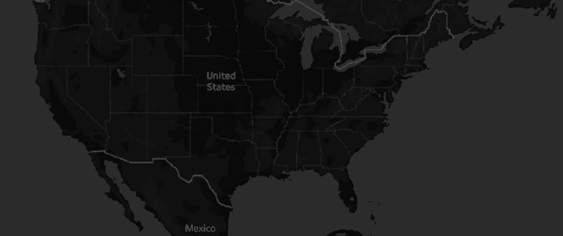

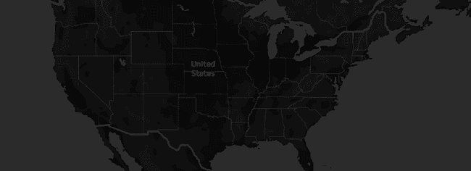
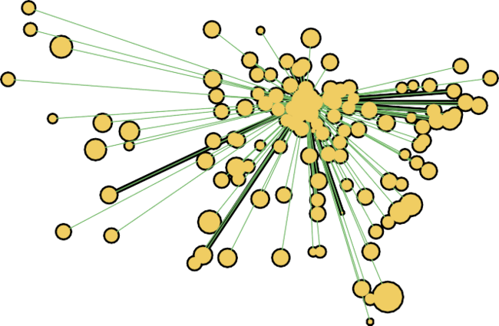

Average Arrival Delay - Envoy
© 2021 Mapbox © OpenStreetMap
Avg. Arr Delay
-25.00
-20.00
-10.00
0.00
13.00
Avg. Arr Delay
To Null
Average Arrival Delay - Republic
© 2021 Mapbox © OpenStreetMap

Slide 13
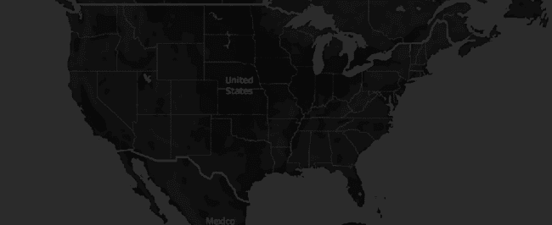
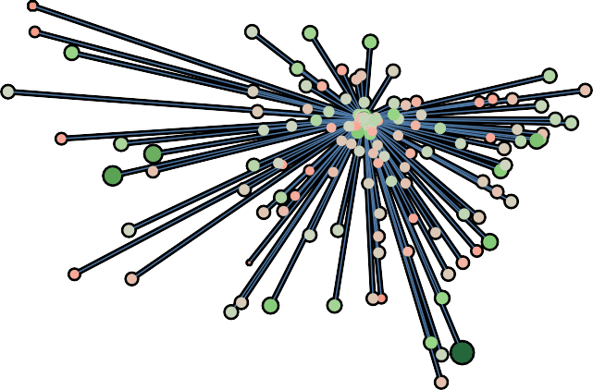
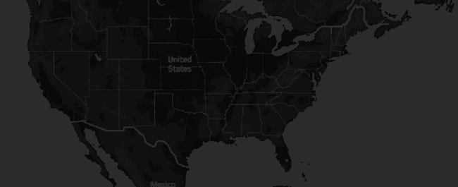
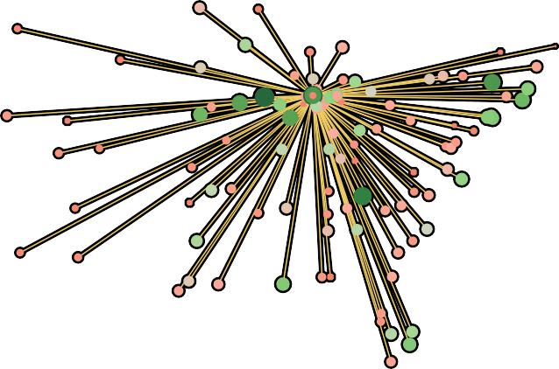
IDS 567 - ENVOY Airline Visualization
Share for Envoy
Arrival Delay (Envoy vs Republic)
Departure Delay (Envoy vs Republic) | Departure Delay Comparison | Delay Reasons
vs Republic at ..
28.72
Average Departure Delay - Envoy
Origin
Null ABE ABI ABQ ABR ABY ACK ACT ACV ACY ADK ADQ AEX AGS AKN ALB ALO ALS ALW AMA ANC APN ASE
Avg. Dep Delay
-11.00
0.00
10.00
20.00
28.72
Avg. Dep Delay
© 2021 Mapbox © OpenStreetMap
-11.00
Avg. Dep Delay
To Null
Average Departure Delay- Republic
© 2021 Mapbox © OpenStreetMap

Slide 14
IDS 567 - ENVOY Airline Visualization
Arrival Delay
Departure Delay (Envoy vs Republic)
Departure Delay Comparison | Delay Reasons | Time Series (Cancelled vs Div..
(Envoy vs Rep..
Delay between two Airports
Avg. Dep Delay
0 5
Origin
DFW
Dest
OMA
-15
-10
-5
10
15
20
ORF PIA PIT SGF XNA CLE
Measure Names Avg. Arr Delay Avg. Dep Delay
Month 8
LGA
DAY GSO JAX
MIA
MEM
0 5 10 15 20 25 30 35 40
Avg. Arr Delay
-30 -25
-20 -15 -10 -5
Delay between two Airports
Avg. Dep Delay
20
Origin
DFW
Dest
ORD
-20
-10
0
10
30
40
50
60
LGA
CLE GSO JAX
MIA
MEM COS
ORD
40
Avg. Arr Delay
-40
-20
0
20
60
80
100
120

Slide 15
400K
300K
Envoy Air
Value
Measure Names
Late Aircraft Del.. Weather Delay Security Delay Nas Delay
200K
Late Aircraft Delay
100K
500K
400K
Late Aircraft Delay
300K
Republic Airways
Value
2
200K
100K
6 7
Month
0 1
3
4
5
8
9
10 11 12 13

Slide 16
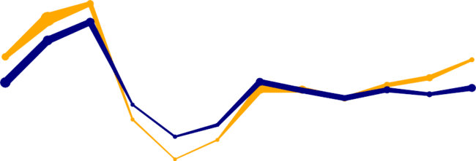
IDS 567 - ENVOY Airline Visualization
Departure Delay Reasons Delay Compari..
Time Series (Cancelled vs Diverted) | TIme Series Arrival Delay | Conclusion
54,658
59,342
4
Time Series Chart of Cancelled Flights Between Envoy and Republic
40K 43,068
53,717
42,176
Flights
30K
35,428
_{34,411} 36,669
28,409
33,017
33,543
35,209
33,256
32,961
20K
30,352
31,602
18,610
Op Unique Carrier Envoy Air Republic Airways
Cancelled
10K
0K
23,866
17,628
11,726
0
1
2
3
4
5
6
7
8
9
10
11
12 13
2,000
4,000
6,000
8,000
10,000
11,071
Time Series Chart of Diverted Flights Between Envoy and Republic
60K
54,658
59,342
50K
53,717
42,176
Diverted
43,068
48,104
_{34,411} 36,669
8.0
Flights
40K
35,428 _{33,017}
50.0
100.0
133.0
28,409
33,543
30K 35,209
33,256
_{30,352} 32,961 _{31,602}
20K
23,866
18,610
17,628
10K
0K
11,726
0
1
2
3
4
5
6
7
8
9
10
11
12 13
Month

Slide 17
Delay Reasons
50K
59,342
54,658
45K
53,717
43,068
40K
48,104
42,176
Flights
35K
30K
35,428
Op Unique Carrier Envoy Air Republic Airways
Arr Delay
34,411
33,017
36,669
35,209
32,767
32,961 _{31,602}
33,543
25K
28,409
30,352
-524,956
-400,000
-200,000
91,365
20K
23,866
22,206
15K
18,610
17,628
10K
11,726
5K
0K
0
1
2
3
4
5
6
Month
7
8
9
10
11
12 13

Slide 18
Distribution of Cancelled Flights by Every Airline per Month
100K Southwest Airlines
Op Unique Carrier Alaska Airline Alegiant Air American Airline Delta Air Lines Endeavor Air Envoy Air ExpressJet Frontier Airline Hawaiian Airlines Horizon Air JetBlue
Mesa Airlines PSA Airlines Republic Airways SkyWest Airlines
Southwest Airlines Spirit Airlines United Airlines
90K
80K
70K
60K
Cancelled
50K
40K
Delta Air Lines
30K
20K
10K
Alegiant Air
Hawaiian Airlines
0K
Horizon Air
0 1 2 3 4 5 6 7 8 9
10
11
12
13
Month
The trend of sum of Cancelled for Month. Color shows details about Op Unique Carrier. The marks are labeled by Op Unique Carrier.

Slide 19
.
.
.
.
.
.
.
.
Spread of Airlines against Distance and Flights
Measure Names Distance
.
.
Measure Names Distance Flights
Op Unique Carrier
.
.
.
.
.
It has most similar values like Envoy Airlines
.
.
.
.
.
.
.
.
.
.
.
.
.
.
.
.
.
.
.
Alask Alegi. Amer Delta Ende Envo Expre Front Hawa Horiz JetBl Mesa PSA ..
Distance and Flights for each Op Unique Carrier. Color shows details about Distance and Flights. The data is ﬁltered on Distance, which keeps non-Null values only.
.
.
Repu. SkyW. Sout. Spirit Unite..
.
.
.
.
.
.
.
.
Repu.. SkyW.. Sout.. Spirit.. Unite..
Distance and Flights for each Op Unique Carrier. Color shows details about Distance and Flights. The data is ﬁltered on Distance, which keeps non-Null values only.

Slide 20
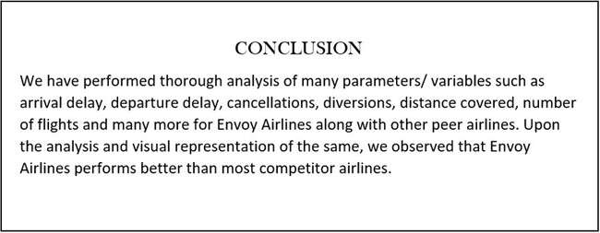
IDS 567 - ENVOY Airline Visualization
. | Time Series (Cancelled vs Diverted) | TIme Series Arrival Delay | Conclusion | Recommendation

Slide 21
